Slide 1
Module 6

Slide 2
Data Link Layer
Two main functions
Data link Control:design and procedures for communication between two adjacent nodes: node-to-node communication.
Medium Access control:media access control, or how to share the link.
Data link control functions:
framing, flow and error control, and software implemented protocols that provide smooth and reliable transmission of frames between nodes.
To implement data link control, we need protocols.
Each protocol is a set of rules that need to be implemented in software and run by the two nodes involved in data exchange at the data link layer.

Slide 3
FRAMING
The data link layer needs to pack bits into frames, so that each frame is distinguishable from another. Our postal system practices a type of framing. The simple act of inserting a letter into an envelope separates one piece of information from another; the envelope serves as the delimiter.
Topics discussed in this section:
Fixed-Size Framing Variable-Size Framing

Slide 4
FRAMING
Fixed-Size Framing:
no need for defining the boundaries of the frames; the size itself can be used as a delimiter.
An example, ATM wide-area network, which uses frames of fixed size called cells.
Variable-Size Framing:
Need to define ending of a frame and beginning of the next frame.
Two approches:
Character-Oriented Protocols
Bit-Oriented Protocols

Slide 5
FRAMING
Character-Oriented Protocols
data to be carried are 8-bit characters from a coding system such as ASCII .
To separate one frame from the next, an 8-bit (1-byte) flag is added at the beginning and the end of a frame.
The flag, composed of protocol-dependent special characters, signals the start or end of a frame.

Slide 6
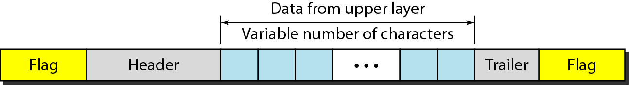
Figure 11.1 A frame in a character-oriented protocol

Slide 7
In byte stuffing (or character stuffing), a special byte is added to the data section of the frame when there is a character with the same pattern as the flag.
The data section is stuffed with an extra byte. This byte is usually called the escape character (ESC), which has a predefined bit pattern.

Slide 8
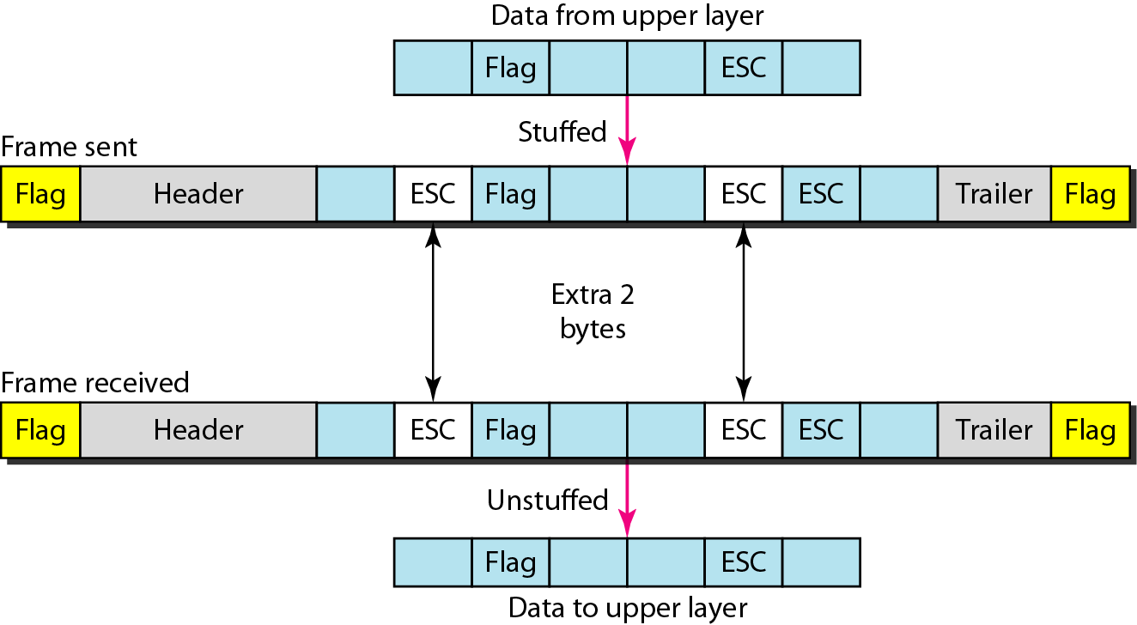
Figure 11.2 Byte stuffing and unstuffing

Slide 9

Note
Byte stuffing is the process of adding 1 extra byte whenever there is a flag or escape character in the text.

Slide 10
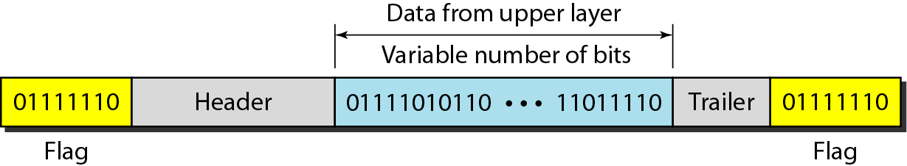
Figure 11.3 A frame in a bit-oriented protocol

Slide 11
Note
Bit stuffing is the process of adding one extra 0 whenever five consecutive 1s follow a 0 in the data, so that the receiver does not mistake
the pattern 0111110 for a flag.

Slide 12
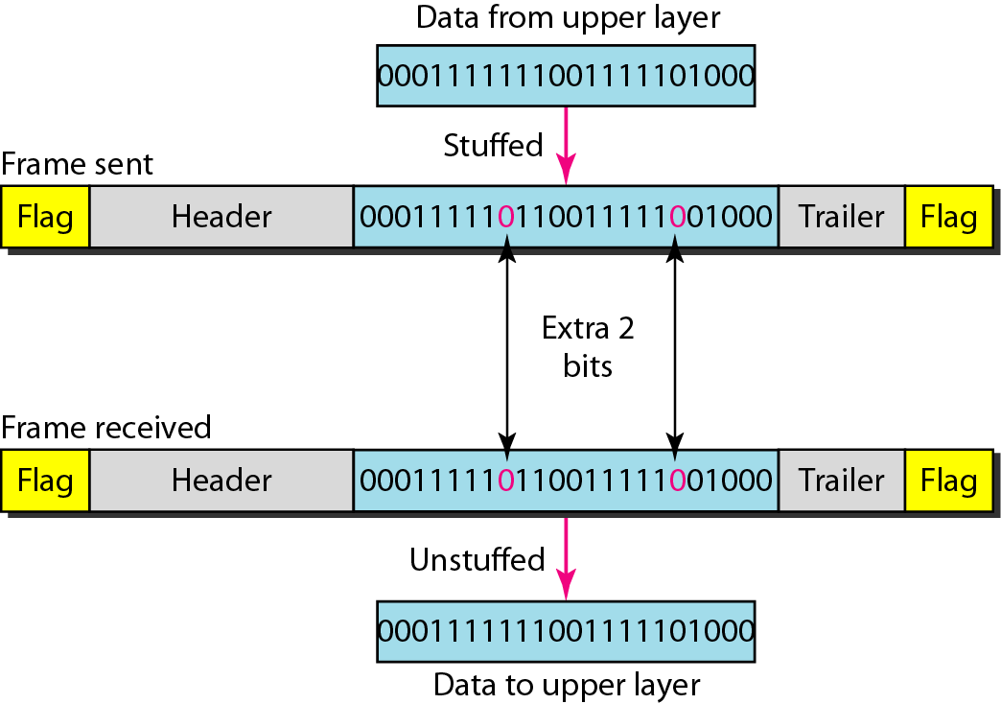
Figure 11.4 Bit stuffing and unstuffing

